Slide 1
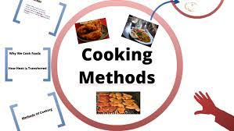
Cooking Methods
Presented by
Urmi Das
Faculty
B.Voc (CTHM)

Slide 2
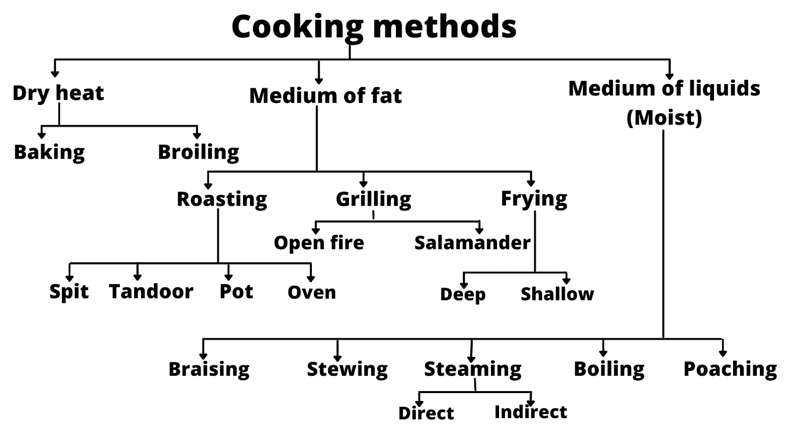
Cooking Methods

Slide 3
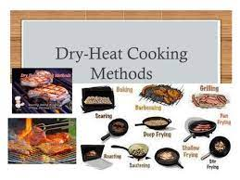
Cooking Methods
Dry methods
Baking
Broiling
Medium of fat
Roasting(low fat)-Spit, tandoor, pot, oven
Grilling-Open fire, Salamander
Frying-deep frying ,shallow frying

Slide 4
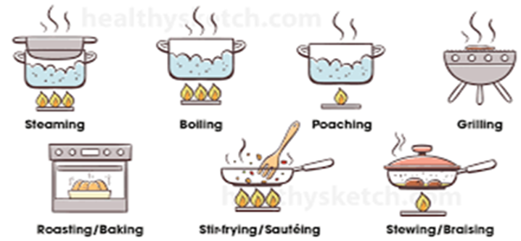
Cooking Methods
Moist medium of liquids
Braising
Stewing
Steaming-Direct steaming,indirect steaming
Boiling
poaching

